Slide 1

Decision-making
Dr. Tateosian
Notes:
Decision-making is one of the most powerful elements of workflow you can implement in computer programming. It allows the code to behave differently based on input such as user arguments or the values in a data field. Decisions allow programs to make choices based on conditions. It can prevent the script from overwriting a database if it already exists; it can check a if a latitude is positive or negative to assign it a hemisphere; it can check if your id is in the user list before giving you access to a website.
This video introduces the importance of decision-making importance in programming and the syntax for implementing it.
-------------------------------
It can check if a database already exists before trying to create it. It can check if a city is in North Carolina before assigning a state flag, it can determine if there are enough user arguments before indexing into the argument list. The database's existence, a city's position relative to North Carolina, and the number of user arguments relative to the number of required arguments, these are all conditions, expressions that can be true of false, also known as Boolean expressions.
This video goes over decision-making syntax in Python and the logic of decision-making.
myList.append( 4 )
mystr.endswith('shp')
arcpy.env.overwriteOutput = 1
arcpy.compact_management(filename)
rc = arcpy.AverageNearestNeighbor_stats('C://points.shp', 'Euclidean Distance') a. print rc.outputcount b. print rc.getOutput(0)

Slide 2

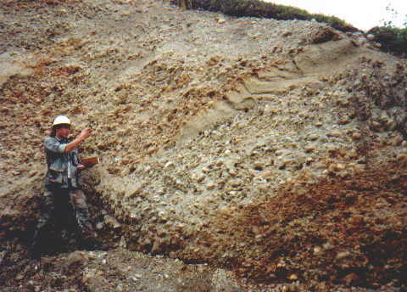
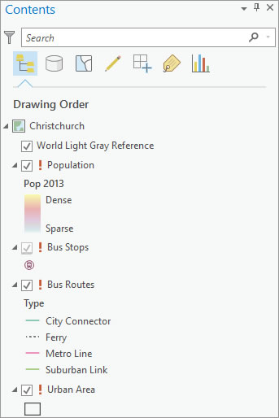
Coding 'decisions' in geospatial applications
IF slope >= 15 THEN
SET grade to steep
ENDIF
IF soil type is top or fill THEN
SET soil_class to1
ELSE IF soil type is alluvium THEN
SET soil_class to 2
ELSE IF soil type is loess THEN
SET soil_class to 3
ELSE
SET soil_class to 4
ENDIF
IF data source is broken THEN
GET data's server
IF server is A THEN
SET path to Server1
ELSE
SET path to Server2
ENDIF
ENDIF
Decisions allow programs to make choices based on conditions.
Notes:
What are some ways you might use decision-making for your geospatial workflows?
It might be as simple as setting the trail difficulty rating based on the change in elevation. For example, if the slope is greater than 15, set the grade to steep.
The geospatial forums are full of questions involving the logic for checking the value of one field to set the value of another field.
For example, you may need to set the soil classification number based on the soil type.
Data management is another common use of decision-making.
The third example is updating map layer sources based on their current data sources.
Decisions allow programs to make choices based on conditions
An expression that is either true or false, is referred to as a "condition" or a "Boolean expression".
The Boolean expression here is Slope > 15%
The bolded phrases in these three examples are the conditions.

Slide 3
Conditions
Decisions allow programs to make choices based on conditions.
IF slope >= 15 THEN
SET grade to steep
ENDIF
IF soil type is top or fill THEN
SET soil_class to1
ELSE IF soil type is alluvium THEN
SET soil_class to 2
ELSE IF soil type is loess THEN
SET soil_class to 3
ELSE
SET soil_class to 4
ENDIF
IF data source is broken THEN
GET data's server
IF server is A THEN
SET path to Server1
ELSE
SET path to Server2
ENDIF
ENDIF
A condition is also referred to as a Boolean expression
Boolean expression – a statement that is either true or false
The workflow will be behave differently depending on the conditions.
Notes:
Let's think about this statement "Decisions allow programs to make choices based on conditions"
A condition is also referred to as a Boolean expression.
Boolean expression – a statement that is either true or false.
The Boolean expression in the first example is "Slope >= 15%"
The bolded phrases in these three examples are the conditions.
The workflow will be behave differently depending on the truth values of these conditions.
These examples use pseudocode. Let's talk about how this looks in Python.

Slide 4

Conditional statement
Used to execute specific blocks of code based on certain conditions
if slope >= 15:
grade = "steep"
print(f"Trail slope: {slope}")
Notes:
In Python, you can use a conditional statement to execute a specific block of code based on certain conditions. This example, sets the trail grade to "steep" and prints the slope if the slope is at least 15 degrees.

Slide 5
Conditional statement
Used to execute specific blocks of code based on certain conditions
if slope >= 15:
grade = "steep"
print(f"Trail slope: {slope}")
Notes:
Here,
if slope >= 15:
is the conditional statement.

Slide 6
Conditional statement
Used to execute specific blocks of code based on certain conditions
if slope >= 15:
grade = "steep"
print(f"Trail slope: {slope}")
Notes:
The specific block of code being executed in this case are the 2nd and 3rd lines, setting grade to steep and printing the trail slope.

Slide 7
"if" statement
Basic format (syntax)
if condition:
# code to execute if condition is True
Example
Block of code
if slope >= 15:
grade = "steep"
print("Trail grade updated")
print(f"Final grade:{grade}")
Notes:
An "if" statement is the simplest form of conditional statement.
The if keyword is followed by a condition (some expression that is evaluated as True or False), followed by a colon.
The block of code that will be executed if the condition is met, is indented one level.
Indentation defines the block of code. When the code is no longer indented, the conditional statement ends.
There is no endif in Python. Dedenting serves this purpose.
Thus, print(f"Final grade: {grade}") is NOT inside the conditional. This means the trail grade gets printed regardless of the condition's truth value.

Slide 8
"else" clause
Provide an alternative block of code to execute when condition is false.
Basic format (syntax)
if condition:
# code to execute if condition is True
else:
# code to execute if condition is False
Example
if slope >= 15:
grade = "steep"
else:
grade = "not steep"
print(f"Final grade:{grade}")
Block of code
Block of code
Notes:
An "if" statement is the simplest form of conditional statement.
The if keyword is followed by a condition (some expression that is evaluated as True or False), followed by a colon.
The block of code that will be executed if the condition is met, is indented one level.
Indentation defines the block of code. When the code is no longer indented, the conditional statement ends.
There is no endif in Python. Dedenting serves this purpose.
Thus, trail_list.append is NOT inside the conditional. This means the trail name gets appended to the trail list regardless of the condition's truth value.

Slide 9
"elif" clause
Short for "else if", clause for handling multiple conditions
Basic format (syntax)
if condition1:
# code to execute if condition1 is True
elif condition2:
# code to execute if condition1 is False and condition2 is True
Example
if slope >= 15:
grade = "steep"
elif slope >= 7:
grade = "moderate"
print(f"Final grade:{grade}")
Notes:
An "if" statement is the simplest form of conditional statement.
The if keyword is followed by a condition (some expression that is evaluated as True or False), followed by a colon.
The block of code that will be executed if the condition is met, is indented one level.
Indentation defines the block of code. When the code is no longer indented, the conditional statement ends.
There is no endif in Python. Dedenting serves this purpose.
Thus, trail_list.append is NOT inside the conditional. This means the trail name gets appended to the trail list regardless of the condition's truth value.

Slide 10
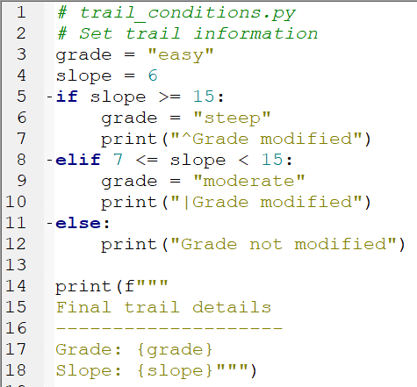
The anatomy of decision-making in Python
keywords if, elif, else
condition (Boolean expression)
slope >= 15
blocks of code
grade = "steep"
print("^Grade modified")
indentation –IDE helps
dedentation
colon
if slope >= 15:
Notes:
To dedent means the opposite of indent (dedent == move to the left one level)
The code shown in the image on this slide is as follows:
# trail_conditions.py # Set trail information grade = "easy" slope = 6 if slope >= 15: grade = "steep" print("^Grade modified") elif 7 <= slope < 15: grade = "moderate" print("|Grade modified") else: print("Grade not modified") print(f""" Final trail details -------------------- Grade: {grade} Slope: {slope}""")

Slide 11
Syntax for branching
if <condition 1>:
print("hi")
elif <condition 2>:
print("ho")
else: print("hey")
if <condition 1>:
print("hi")
else:
print("ho")
if <condition 1>:
print("hi")
Pop quiz
How many elif blocks of code can you have?
How many else blocks can go with each if block?
Is the else block required?
Which of these examples always prints something?
If conditional statement 1 is true, will all of these examples print something?
For the last box, Give an example for conditional statements 1 and 2 so that ‘ho’ would never be printed.
if <conditional 1>:
print("hi")
elif <condition 2>:
print("ho")
Notes:
How many elif blocks of code can you have? sky’s the limit, but if you have many, there’s probably a better way to do it…(Google ‘Python dictionary’)
How many else blocks can go with each if block? at most one
Is the else block required? No
Which of these examples always print something? The first two.
If conditional statement 1 is true will all of these examples print something? Yes, they’ll all print ‘hi’
Give an example for conditional statements 1 and 2 so that ‘ho’ would never be printed. cs1: x < 10 cs2: x < 9

Slide 12
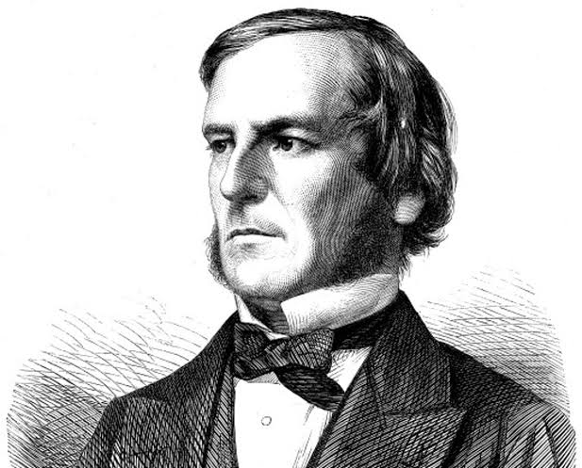
Boolean logic for decision-making
Boolean expression: Expression that is either True or False.
Mathematician, George Boole, 1815-1864
Notes:
Boolean logic, conceived by George Boole, is considered to as foundation for the information age. Boolean logic is a type of algebra in which all expressions are calculated as either true or false. All aspects of computing, from your ArcGIS Project files to your Google directions to the convenience store, at the very core, are based on combinations of binary values. This video will familiarize you with logic concepts you need to automate decision-making in geospatial applications.

Slide 13


Boolean in Python
bool (Stands for Boolean)
1) A data type
Built-in constants True and False are the only values of this data type.
2) A built-in function
Returns True or False for a given expression.
Notes:
In Python bool, which stands for Boolean, is two things.
A data type. Built-in constants True and False are the only values of this data type.
A built-in function. Returns True or False for a given expression.

Slide 14

bool function
The bool function casts the input expression to Boolean (True or False).
bool(x) returns True when the argument x is true, False otherwise.
>>> num = 5
>>> bool(num > 4)
True
>>> bool(num)
True
>>> my_list = []
>>> bool(my_list)
False
Notes:
The bool function casts the input expression to Boolean. Since the only value that a Boolean can have is True or False, it either returns True or False.
import sys
x = 5
bool(x <= 0 or x >= 10)
ssn = "123-45-6789"
bool(not ssn.isalpha())
import os
out_dir = "C:/temp"
if not os.path.exists("C:/temp"):
os.mkdir(out_dir)
my_files = os.listdir(out_dir)
if not my_files:
print(f"{out_dir} is empty.")
if 20 < weight < 40 and 3 <= age <= 5:
seat = "booster"
x = 5
y = 6
bool(x >= y)
my_list = []
bool(my_list)
place = "Hawaii"
bool(place)
bool("ha" in place.lower() or "ba" in place.lower())
country = "United States of America"
country.startswith("Un") and "State" in country

Slide 15
Built-in False Objects in Python
False
None
0
""
()
[]
{}
All other numbers, strings, lists, tuples, & dictionaries are True.

Slide 16
Truth testing with bool
The bool function can be used to test the truth value of an expression.
>>> place = "Hawaii"
>>> bool(place)
True
>>> my_list = []
>>> bool(my_list)
False
>>> x = 5
>>> y = 6
>>> bool(x != y)
True
>>> bool("ha" in place.lower() or "ba" in place.lower())
True
Notes:
The bool function casts
import sys
x = 5
bool(x <= 0 or x >= 10)
ssn = "123-45-6789"
bool(not ssn.isalpha())
import os
out_dir = "C:/temp"
if not os.path.exists("C:/temp"):
os.mkdir(out_dir)
my_files = os.listdir(out_dir)
if not my_files:
print(f"{out_dir} is empty.")
if 20 < weight < 40 and 3 <= age <= 5:
seat = "booster"
x = 5
y = 6
bool(x >= y)
my_list = []
bool(my_list)
place = "Hawaii"
bool(place)
bool("ha" in place.lower() or "ba" in place.lower())
country = "United States of America"
country.startswith("Un") and "State" in country

Slide 17
Operators
The bool function casts the input to Boolean.
>>> place = "Hawaii"
>>> bool(place)
True
>>> my_list = []
>>> bool(my_list)
False
>>> x = 5
>>> y = 6
>>> bool(x != y)
True
>>> bool("ha" in place.lower() or "ba" in place.lower())
True
Comparison operator
Logical operator
Notes:
The bool function casts
import sys
x = 5
bool(x <= 0 or x >= 10)
ssn = "123-45-6789"
bool(not ssn.isalpha())
import os
out_dir = "C:/temp"
if not os.path.exists("C:/temp"):
os.mkdir(out_dir)
my_files = os.listdir(out_dir)
if not my_files:
print(f"{out_dir} is empty.")
if 20 < weight < 40 and 3 <= age <= 5:
seat = "booster"
x = 5
y = 6
bool(x >= y)
my_list = []
bool(my_list)
place = "Hawaii"
bool(place)
bool("ha" in place.lower() or "ba" in place.lower())
country = "United States of America"
country.startswith("Un") and "State" in country

Slide 18
Composing Boolean expressions
Conditions can include comparison and logical operators.
Comparison operators >, <, <=,>=
!= not equal == equal
Logical operators and, or, and not
Notes:
Conditions can include any of these comparison and logical operators.

Slide 19
Comparison operators
>, <, <=,>=
!= not equal == equal
x > y # x is greater than y
x < y # x is less than y
x >= y # x is greater than or equal to y
x <= y # x is less than or equal to y
x != y # x is not equal to y
x == y # x is equal to y
Note: Assignment (=) versus comparison (==)
>>> x = 5 # assignment statement
>>> y = x
>>> y == x
True
>>> y = x + 1
>>> y == x # comparison statement
False
>>> print(y)
6
>>> print(x)
5
Notes:
Most Python comparison operators are already familiar from mathematics.

Slide 20
Ordering
>, <, <=,>=
These comparison operators use the ordering defined by Python.
Compare numbers with numbers. Numerical ordering ✓
Compare strings with strings. alpha characters use alphabetical ordering
But which is larger, "a" or "b"? How about "A" versus "a"?
>>> bool("a" < "b")
True
>>> bool("A" > "a")
False
String ordering works from left to right until a deference is detected.
>>> bool("Geographic Info Science" < "Geographic Info Systems")
True
>>> bool("19" < "128")
False

Slide 21


Comparing num vs strings
In Python 3, there is no ordering defined between numbers and strings.
>>> bool(1 < "a")
TypeError: '<' not supported between instances of 'int' and 'str'
You can check for equality...
>>> bool(1 == "a")
False
...or inequality between numbers and strings.
>>> bool(1 != "a")
True
number
>, <, <=,>=
string
==, !=
number
string

Slide 22
Comparison gotcha
# getlat.py
import sys
lat = sys.argv[1]
if lat > 180:
print("Please enter a valid latitude.")
TypeError: '<' not supported between instances of 'str' and 'str'
--------------------------------------------------------------
# getlat_corrected.py
import sys
lat = float(sys.argv[1])
if lat > 180:
print("Please enter a valid latitude.")
When getting numerical user arguments, it's usually best to cast them immediately, at the variable assignment, and only store them as numbers.

Slide 23
Common comparison operator mistakes
Python
Not Python
<=
>=
!=
Backwards
=>
=<
=!
Can't type this
≤
≥
≠
SQL, not Python
<>

Slide 24
Logical Operators
and, or, not
>>> country = "United States of America"
>>> bool(country.startswith("Un") and "State" in country) True
>>> x = 5
>>> bool(x <= 0 or x >= 10)
False
>>> ssn = "123-45-6789"
>>> bool(not ssn.isalpha())
True
Notes:
------------------------------------------------------------
DEMO2: LOGICAL OPERATORS, BOOLEAN EXPRESSIONS and ASSIGNMENT
************************************************************
>>> 5==5
True
>>> 5>0
True
>>> 5<-10
False
>>> s1=''
>>> s2=' '
>>> s1 != s2
True
>>> x = 5
>>> x>0 and x<10
True
>>> 0<x<10
True
>>> True + False + 10
11
>>> False == 0
True
>>> False == 1
False
>>> 'alpha'> 'beta'
False

Slide 25
Logical operators for compound expressions
and, or, not
>>> country = "United States of America"
>>> bool(country.startswith("Un") and "State" in country) True
>>> x = 5
>>> bool(x <= 0 or x >= 10)
False
>>> ssn = "123-45-6789"
>>> bool(not ssn.isalpha() and not len(ssn) > 11)
True
Notes:
------------------------------------------------------------
DEMO2: LOGICAL OPERATORS, BOOLEAN EXPRESSIONS and ASSIGNMENT
************************************************************
>>> 5==5
True
>>> 5>0
True
>>> 5<-10
False
>>> s1=''
>>> s2=' '
>>> s1 != s2
True
>>> x = 5
>>> x>0 and x<10
True
>>> 0<x<10
True
>>> True + False + 10
11
>>> False == 0
True
>>> False == 1
False
>>> 'alpha'> 'beta'
False

Slide 26
Chaining comparison to replace 'and'
0 10
>>> x = 3
>>> (x > 0) and (x <= 10)
True
>>> 0 < x <= 10
True
>>> (x < 0) or (x >= 10)
False
Equivalent
0 10
Notes:
------------------------------------------------------------
DEMO2: LOGICAL OPERATORS, BOOLEAN EXPRESSIONS and ASSIGNMENT
************************************************************
>>> 5==5
True
>>> 5>0
True
>>> 5<-10
False
>>> s1=''
>>> s2=' '
>>> s1 != s2
True
>>> x = 5
>>> x>0 and x<10
True
>>> 0<x<10
True
>>> True + False + 10
11
>>> False == 0
True
>>> False == 1
False
>>> 'alpha'> 'beta'
False

Slide 27
Using operators in conditions
if 20 < weight < 40 and 3 <= age <= 5:
seat = "booster"
elif age < 3:
seat = "high chair"
vowels = ["a", "e", "i", "o", "u"]
if char in vowels or char == "#":
vowel_hash_list.append(char)
my_files = os.listdir(out_dir)
if not my_files:
print(f"{out_dir} is empty.")
if not os.path.exists(out_dir):
os.mkdir(out_dir)
Notes:
------------------------------------------------------------
DEMO2: LOGICAL OPERATORS, BOOLEAN EXPRESSIONS and ASSIGNMENT
************************************************************
>>> 5==5
True
>>> 5>0
True
>>> 5<-10
False
>>> s1=''
>>> s2=' '
>>> s1 != s2
True
>>> x = 5
>>> x>0 and x<10
True
>>> 0<x<10
True
>>> True + False + 10
11
>>> False == 0
True
>>> False == 1
False
>>> 'alpha'> 'beta'
False

Slide 28

Take-aways
Conditional statements
Decision-making syntax
Boolean Expressions
Comparison operators
Logical operators
Take-aways
Notes:
Conditional statements are used to execute specific blocks of code based on certain conditions
Decision-making syntax uses if, elif, and ellse keywords, conditions, colons, and indentation
Bool function can be used for truth testing
Comparison operators can compare numbers or strings, but not numbers with strings
Logical operators and, or, not can be used to form compound expressions.

Slide 29

Common decision-making code mistakes
COMMON MISTAKES
Praemonitus, Praemunitus
–Forewarned is forearmed.
Notes:
Decision-making workflows are powerful, but they can often introduce mistakes into the code. As the saying goes, forewarned is forearmed, so let's arm ourselves by reviewing with some coping techniques and exposure to common mistakes.

Slide 30
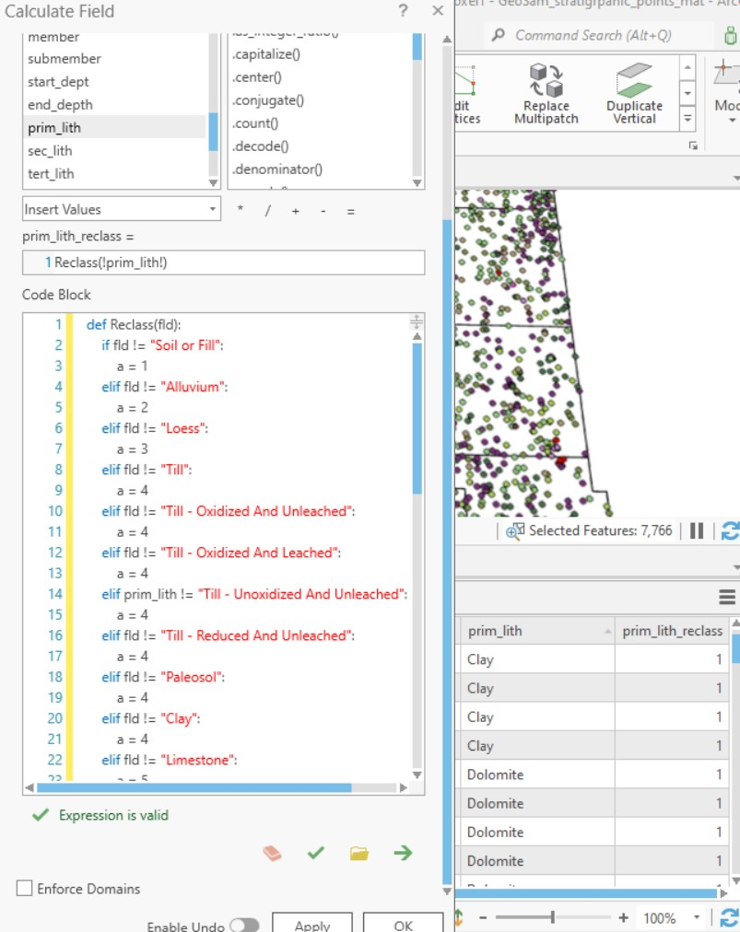
How to improve this decision-making code?
"I am trying to use a Python Code Block to use existing text field !prim_lith! (with geologic material descriptions, e.g., clay, sand) to populate a new integer field !prim_lith_reclass! whose value 1, 2, 3,...,9 depends on the geologic material in !prim_lith!."
(Anonymous Esri community member)
Notes:
First, take a look at this forum post. This person is trying to use Python in the calculate field tool, to use descriptive geological material names to set a numeric class field. Can you spot any ways you might improve this code? We'll come back to this again after looking through some issues.

Slide 31
Boolean Expression Review
Boolean expression: expression that is either True or False.
A conditional statement consists of Boolean expressions with logical and comparison operators.
Logical operators and, or, and not
Comparison operators
>, <, <=,>=
!= not equal == equal
False in Python:
False
None
0
""
()
[]
{}
All other numbers, strings,
lists, dictionaries, tuples
evaluate as True
Notes:
Frist, recall that we have logical and comparison operators. And that there are few values in Python that evaluate as False. The vast majority of values evaluate as True.

Slide 32
Meaning of and, or, and not
Truth table
--List all possible combinations of truth values (T or F) for logical expressions.
--Determine the resulting truth values (T or F) for each combination of inputs.
p and q represent independent logical statements. Examples of statements: slope > 15
That's my dog
The soil is clay Combining statements with logical operators
p: It's raining
q: Today is Friday
p and q
It's raining and today is Friday
p or q
It's raining or today is Friday
not p
It's not raining.
p | not p
T | F
F | T
p | q | p and q
T | T | T
F | T | F
T | F | F
F | F | F
p | q | p or q
T | T | T
F | T | T
T | F | T
F | F | F
Notes:
For those logical operators, familiarity with truth tables can be helpful.
Truth tables are an organized means for reasoning about logical statements.
To create a truth table, you list all the possible combinations of T or F values for logical expresssionsl
Then you determine the truth values of compound statements for each of these combinations.
For simplicity, the tables usually use letters such as p, q, and r to represent logical statements.
For example, a statement, p, could be ... slope > 15 , or It's raining, or, Today is Friday
Say p is it's raining and q is Today is Friday. Then p and q means, it's raining and today is Friday. .... you can make a truth table for p and q

Slide 33
Testing the branches
Aim to cover all possible branches of your decision-making statements. Test cases should include inputs that make the condition true,
inputs that make it false,
inputs that are on the boundary of the conditions.
For example, you want #'s between 0 and 10, test with values like -1, 0, 1, 10, and 11.
For each test case, define what the expected outcome should be. This could be a specific result, an error message, or no action at all.
x
0 10
Test | -1 | 0 | 1 | 10 | 11
Expected outcome | No | No | Yes | Yes | No

Slide 34
Common mistake: 'Or' instead of 'and'
0 10
>>> x = 3
>>> (x > 0) or (x <= 10)
True
>>> (x > 0) and (x <= 10)
True
>>> 0 < x <= 10
True
Test | -1 | 0 | 1 | 10 | 11
Expected outcome | No | No | Yes | Yes | No
Use 'and' to require two things
Notes:
------------------------------------------------------------
DEMO2: LOGICAL OPERATORS, BOOLEAN EXPRESSIONS and ASSIGNMENT
************************************************************
>>> 5==5
True
>>> 5>0
True
>>> 5<-10
False
>>> s1=''
>>> s2=' '
>>> s1 != s2
True
>>> x = 5
>>> x>0 and x<10
True
>>> 0<x<10
True
>>> True + False + 10
11
>>> False == 0
True
>>> False == 1
False
>>> 'alpha'> 'beta'
False

Slide 35
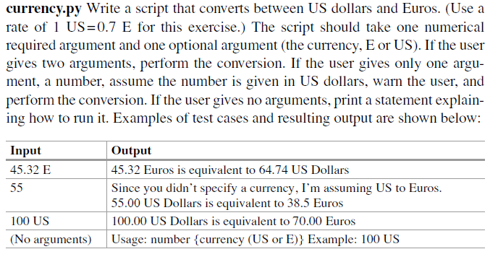


















Test and Expected outcomes
Test cases
Expected outcomes
Notes:
------------------------------------------------------------
DEMO2: LOGICAL OPERATORS, BOOLEAN EXPRESSIONS and ASSIGNMENT
************************************************************
>>> 5==5
True
>>> 5>0
True
>>> 5<-10
False
>>> s1=''
>>> s2=' '
>>> s1 != s2
True
>>> x = 5
>>> x>0 and x<10
True
>>> 0<x<10
True
>>> True + False + 10
11
>>> False == 0
True
>>> False == 1
False
>>> 'alpha'> 'beta'
False

Slide 36
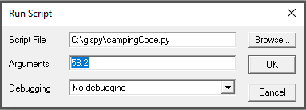
Common mistake: Apples & Oranges
Test | -1 | 40 | 58.2
Expected outcome | cancel | cancel | don't cancel
import sys
temperature = sys.argv[1]
if temperature <= 40: camping_trip = "cancelled"
---------------------------------------------------
import sys
temperature = float(sys.argv[1])
if temperature <= 40: camping_trip = "cancelled"
TypeError
Cast numbers at the outset.

Slide 37
Punctuation required
camping_trip = "proceed_as_scheduled"
if temperature <= 40 or temperature >= 90
camping_trip = "cancelled"
elif 60 <= temperature <= 78
camping_trip = "extended"
---------------------------------------------------
camping_trip = "proceed_as_scheduled"
if temperature <= 40 or temperature >= 90:
camping_trip = "cancelled"
elif 60 <= temperature <= 78:
camping_trip = "extended"
SyntaxError

Slide 38
Indentation required
camping_trip = "proceed_as_scheduled"
if temperature <= 40 or temperature >= 90:
camping_trip = "cancelled"
elif 60 <= temperature <= 78:
camping_trip = "extended"
---------------------------------------------------
camping_trip = "proceed_as_scheduled"
if temperature <= 40 or temperature >= 90:
camping_trip = "cancelled"
elif 60 <= temperature <= 78:
camping_trip = "extended"
SyntaxError

Slide 39
Common mistake:Over-condition-ing
if population <= 40_000:
size = 1
elif 40_000 < population <= 400_000:
size = 2
else population > 400_000:
size = 3
---------------------------------------------------
if population <= 40_000:
size = 1
elif 40_000 < population <= 400_000:
size = 2
else:
size = 3
SyntaxError
ELSE can't have a condition.

Slide 40
Common mistake: Over-if-ing
if population <= 40_000:
size = 1
if 40_000 < population <= 400_000:
size = 2
---------------------------------------------------
if population <= 40_000:
size = 1
elif 40_000 < population <= 400_000:
size = 2
Inefficient
Avoid redundant checks.

Slide 41
Common mistake: Over-elif-ing
if population <= 40_000:
size = 1
elif 40_000 < population <= 400_000:
size = 2
elif population > 400_000:
size = 3
---------------------------------------------------
if population <= 40_000:
size = 1
elif 40_000 < population <= 400_000:
size = 2
else:
size = 3
Inefficient
Avoid unnecessary checks.

Slide 42
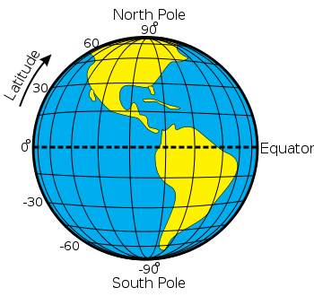
Use full statements
latitude <= 0
30 <= latitude <= 60
-60 <= latitude <= -30 or 30 <= latitude <= 60
latitude <-30 or latitude >= 30
latitude <-30 or >= 30
SyntaxError

Slide 43
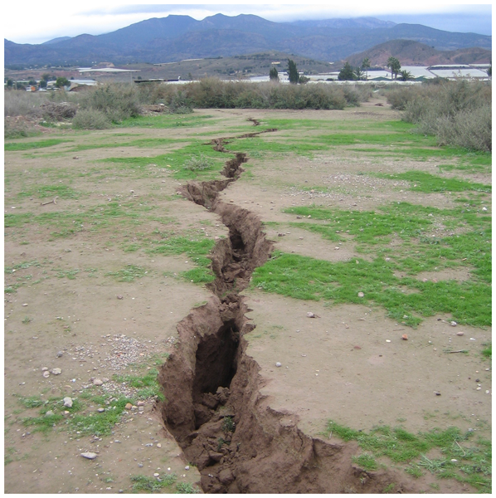
and, or fissure the expression
latitude <-30 or >=30
Use complete expressions on both the left and right of "or", "and"
operators
Image credit: https://piahs.copernicus.org/articles/382/663/2020/
Notes:
Image credit: https://piahs.copernicus.org/articles/382/663/2020/

Slide 44
Invalid incomplete expressions
camping_trip = "proceed_as_scheduled"
if temperature <= 40 or >= 90:
camping_trip = "cancelled"
elif 60 <= temperature and <= 78:
camping_trip = "extended"
---------------------------------------------------
camping_trip = "proceed_as_scheduled"
if temperature <= 40 or temperature >= 90:
camping_trip = "cancelled"
elif 60 <= temperature <= 78:
camping_trip = "extended"
SyntaxError

Slide 45
Valid but in complete expression
Statements must be complete on each side of operator.
Example: print when the species is salmon or tuna
if species == "salmon" or "tuna": print(species)
Test cases?
salmon
tuna
some other species
INCORRECT SOLUTION
>>> species = "salmon"
>>> if species == "salmon" or "tuna":
... print(species)
...
salmon
>>> species = "tuna"
>>> if species == "salmon" or "tuna":
... print(species)
...
tuna
>>> species = "pike"
>>> if species == "salmon" or "tuna":
... print(species)
...
pike
Test | salmon | tuna | pike
Expected outcome | Print | Print | Don't print
Notes:
------------------------------------------------------------
DEMO2: LOGICAL OPERATORS, BOOLEAN EXPRESSIONS and ASSIGNMENT
************************************************************
>>> 5==5
True
>>> 5>0
True
>>> 5<-10
False
>>> s1=''
>>> s2=' '
>>> s1 != s2
True
>>> x = 5
>>> x>0 and x<10
True
>>> 0<x<10
True
>>> True + False + 10
11
>>> False == 0
True
>>> False == 1
False
>>> 'alpha'> 'beta'
False

Slide 46
Valid but in complete expression
Test | salmon | tuna | pike
Expected outcome | Print | Print | Don't print
Statements must be complete on each side of operator.
Example: print when the species is salmon or tuna
if species == "salmon" or "tuna": print(species)
if species == "salmon" or species == "tuna": print(species)
INCORRECT SOLUTION
true…
so the entire statement is always true
CORRECT SOLUTION
Notes:
------------------------------------------------------------
DEMO2: LOGICAL OPERATORS, BOOLEAN EXPRESSIONS and ASSIGNMENT
************************************************************
>>> 5==5
True
>>> 5>0
True
>>> 5<-10
False
>>> s1=''
>>> s2=' '
>>> s1 != s2
True
>>> x = 5
>>> x>0 and x<10
True
>>> 0<x<10
True
>>> True + False + 10
11
>>> False == 0
True
>>> False == 1
False
>>> 'alpha'> 'beta'
False

Slide 47

Distributing negation
Beware of English language to logic statement conversions.
Example: Print the species if it’s not a trout or catfish.
if species != "trout" or "catfish":
print(species)
if species != "trout" or species != "catfish":
print(species)
if species != "trout" and species != "catfish":
print(species)
DeMorgan’s law: ~(p or q) ↔ ~p and ~q
Test | cod | trout | catfish
Expected outcome | Print | Don'tprint | Don't print
SOLUTION?
True all the time. If species is trout,...
the left side is False, but right side is True.
SOLUTION?
SOLUTION?
Notes:
DeMorgan’s law ~(p or q) ↔ ~p and ~q
------------------------------------------------------------
DEMO2: LOGICAL OPERATORS, BOOLEAN EXPRESSIONS and ASSIGNMENT
************************************************************
>>> 5==5
True
>>> 5>0
True
>>> 5<-10
False
>>> s1=''
>>> s2=' '
>>> s1 != s2
True
>>> x = 5
>>> x>0 and x<10
True
>>> 0<x<10
True
>>> True + False + 10
11
>>> False == 0
True
>>> False == 1
False
>>> 'alpha'> 'beta'
False

Slide 48
How to improve this decision-making code?
"I am trying to use a Python Code Block to use existing text field !prim_lith! (with geologic material descriptions, e.g., clay, sand) to populate a new integer field !prim_lith_reclass! whose value 1, 2, 3,...,9 depends on the geologic material in !prim_lith!."
(Anonymous Esri community member)
Notes:
def Reclass(fld): if fld=='soil or fill': return 1 elif fld=='alluvium': return 2 else: return 9
https://community.esri.com/t5/arcgis-pro-questions/calculate-field-helpers-reclassify-if-elif/m-p/1106085?search-action-id=84653597253&search-result-uid=1106085
I am trying to use Python / Code Block to use existing field !prim_lith! (text field, with geologic material descriptions, eg, clay, sand) to populate a new field !prim_lith_reclass! (short integer field) whose value 1, 2, 3,...9 depends on the geologic material in !prim_lith!. The Expression is valid and runs but the return values are all equal to 1 (from line 3 in the code block), see lower right of attached jpg. I've tried varied syntax etc. but nothing seems to work. Should text be in double quotes "text", or double apostrophe 'text' ? What is the difference between != and == ? Do I have to explicitly enter an Else?

Slide 49
2 ways to improve this decision-making code
replace != with ==
Example:
if fld == "Soil or Fill":
2. Handle a = 4 soils more efficiently
elif fld in ["Till", "Till-Oxidized and Unbleached", ... ,"Clay"]:
Notes:
def Reclass(fld): if fld=='soil or fill': return 1 elif fld=='alluvium': return 2 else: return 9
https://community.esri.com/t5/arcgis-pro-questions/calculate-field-helpers-reclassify-if-elif/m-p/1106085?search-action-id=84653597253&search-result-uid=1106085
I am trying to use Python / Code Block to use existing field !prim_lith! (text field, with geologic material descriptions, eg, clay, sand) to populate a new field !prim_lith_reclass! (short integer field) whose value 1, 2, 3,...9 depends on the geologic material in !prim_lith!. The Expression is valid and runs but the return values are all equal to 1 (from line 3 in the code block), see lower right of attached jpg. I've tried varied syntax etc. but nothing seems to work. Should text be in double quotes "text", or double apostrophe 'text' ? What is the difference between != and == ? Do I have to explicitly enter an Else?

Slide 50

Capturing the big picture
Avoid syntax & type errors
Use colons & indentation.
Cast numbers at the outset.
ELSE can't have a condition.
Use complete comparisons L/R.
Avoid logic errors
Use 'and' to require 2 conditions.
Use complete statements L/R.
Be efficient
Avoid redundant checking.
Use simple solutions.
Test against expected outcomes.
Debug

Slide 51

Truth tables

Slide 52
Truth tables for testing logic
p | q | p and q
T | T | T
F | T | F
T | F | F
F | F | F
Truth table
--List all possible combinations of truth values (T or F) for logical expressions.
--Determine the resulting truth values (T or F) for each combination of inputs.
p, q, and r represent Boolean expressions. slope > 15
It's raining
Today is Friday Combining statements with logical operators
p: It's raining
q: Today is Friday
p and q
It's raining and today is Friday
p or q
It's raining or today is Friday
nor p
It's not raining.
p | not p
T | F
F | T
p | q | p or q | not p
T | T | T | F
F | T | T | T
T | F | T | F
F | F | F | T
p | q | not p | (not p) and q
T | T | F | F
F | T | T | T
T | F | F | F
F | F | T | F
Notes:
A familiarity with introductory logic is helpful in writing well formed conditional code and debugging errors.

Slide 53
Truth tables
p: It's raining
q: Today is Friday
r: Traffic is heavy
(p or q) and r
It's raining or today is Friday, and traffic is heavy.
p | q | r | p or q | (p or q) and r
T | T | T | T | T
F | T | T | T | T
T | F | T | T | T
F | F | T | F | F
T | T | F | T | F
F | T | F | T | F
T | F | F | T | F
F | F | F | F | F

Slide 54
Branching workflow example
You're building a geospatial analysis tool, and users can input various types of geospatial datasets (e.g., shapefiles, rasters, feature classes). Depending on the data type, you might want to perform different types of analyses.
if species == "trout" or "catfish":
print(species)
if species == "trout" or species == "catfish":
print(species)
if species != "trout" and species != "catfish":
print(species)
DeMorgan’s law: ~(p or q) ↔ ~p and ~q
SOLUTION?
True all the time. If species is trout,...
the left side is False, but right side is True.
SOLUTION?
SOLUTION?
Notes:
DeMorgan’s law Logic review: ~(p V q) ↔ ~p and ~q
------------------------------------------------------------
DEMO2: LOGICAL OPERATORS, BOOLEAN EXPRESSIONS and ASSIGNMENT
************************************************************
>>> 5==5
True
>>> 5>0
True
>>> 5<-10
False
>>> s1=''
>>> s2=' '
>>> s1 != s2
True
>>> x = 5
>>> x>0 and x<10
True
>>> 0<x<10
True
>>> True + False + 10
11
>>> False == 0
True
>>> False == 1
False
>>> 'alpha'> 'beta'
False

Slide 55
Branching workflow example
kml preparation tool. Different for vector/raster/other datatypes. Different for points/lines/polygon. Different for TIFs and other formats.
How can I determine what type of data I have?
GET data type
feature class
shapefile
raster
other
PRINT
'warning, knuckle head'
GET shape type
GET format
point
line
polygon
other
TIF
other
CALL point
to kml
CALL line
to kml
CALL polygon
to kml
CALL layer
to kml
CALL
convert to TIFF

Slide 56
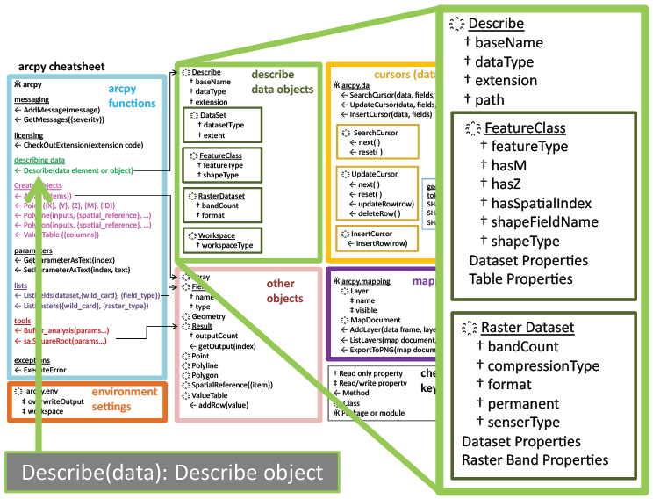
Describe Object
desc = arcpy.Describe(rastfile)

Slide 57
Creating a describe object
>>> # Create geoprocessing objects >>> import arcpy
>>> # Set the data element >>> rastfile = 'C:/Temp/raster1'
>>> # Call describe method >>> dsc = arcpy.Describe(rastfile)
>>> print(dsc) <geoprocessing describe data object object at 0x0092D2D0>
object.method(arg1,arg2, …)
describe object
data element to be described

Slide 58
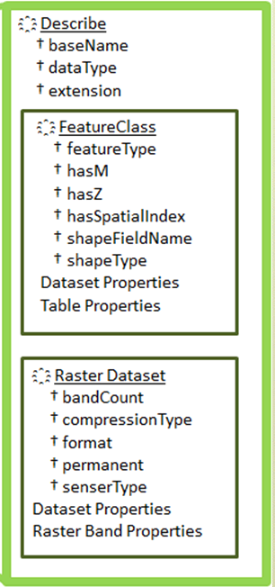
Using a describe object
>>> import arcpy >>> rastfile = 'C:/Temp/raster1' >>> dsc = arcpy.Describe(rastfile) >>> print(dsc.datatype) 'RasterDataset'
>>> print(dsc.format) 'IMAGINE image‘
See note view for demo
Notes:
>>> import arcpy
>>> file = 'C:/Temp/COVER63p.shp'
>>> dsc = arcpy.Describe(file)
>>> dsc.Format
Traceback (most recent call last): File "<interactive input>", line 1, in ?
RuntimeError: describe method: Format does not exist
>>> dsc.ShapeType
'Polygon‘
>>> dsc.HasOID
True
>>> dsc.DatasetType
‘Shapefile'

Slide 59
Selection Syntax
Convert the pseudocode to Python
Python conditional keywords: if, elif, else
Use a describe object to get the shapeType
Python
import arcpy
mydata = "C:/Temp/data.shp"
dsc = arcpy.Describe(mydata)
shapeType = dsc.shapeType
if shapeType == "Polygon":
print("Shape is polygon")
elif shapeType == "Polyline":
print("Shape is line")
else:
print("Shape is not line or polygon")
Pseudocode
GET shapefile
GET shape type
IF shape type is polygon THEN PRINT shape is polygon
ELSE IF shape type is line THEN PRINT shape is line
ELSE
PRINT shape isn’t line or polygon ENDIF

Slide 60
Using describe with caution
Previous slide
import arcpy
mydata = "C:/Temp/data.shp"
dsc = arcpy.Describe(mydata)
shapeType = dsc.ShapeType
if shapeType == "Polygon":
print("Shape is polygon")
elif shapeType == "Polyline":
print("Shape is line")
else:
print("Shape is not \
line or polygon")
More cautiously
import arcpy
mydata = "C:/Temp/data.shp"
dsc = arcpy.Describe(mydata)
if dsc.dataType == "ShapeFile":
shapeType = dsc.ShapeType
if shapeType == "polygon":
print("Shape is polygon")
elif shapeType == "Polyline":
print("Shape is line")
else:
print("Shape is not \
line or polygon")

Slide 61
Summing up
Topics discussed
Conditional statements
Decision-making syntax
Boolean Expressions
Logical operators
Comparison operators
Describing ArcGIS data
Coming up
Looping
Additional topics
Tools that make selections
Select by attributes
Compound vs. nested conditions
Testing conditions
Using os module to check for files

Slide 62
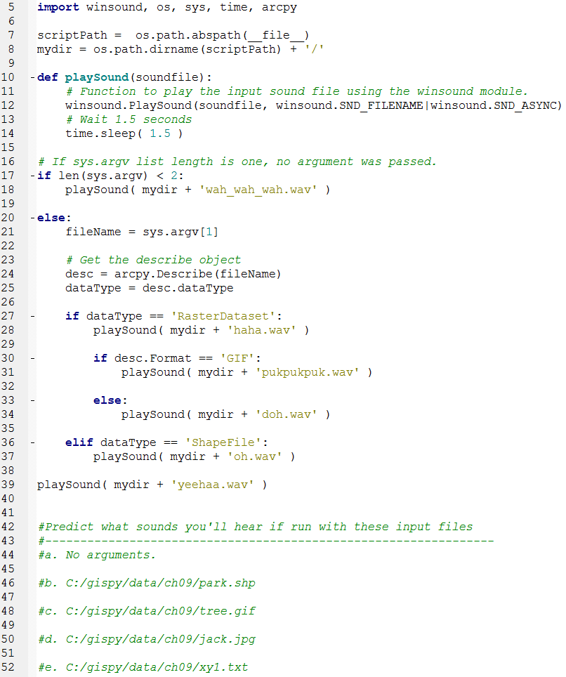
In class – conditionalSound.py

Slide 63
Appendix I

Slide 64
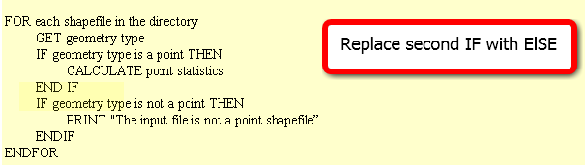
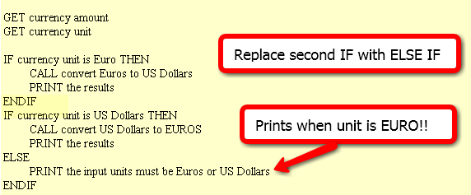
In class – Poor form! FIX IT
Point statistics
2. Currency conversion
3. Grader
IF average < 60
NULL
ELSE
DO GivePassingGrade
ENDIF

Slide 65
FIX IT
Point statistics
2. Currency conversion
3. It is considered poor form to have a 1-sided IF stmt where the action is on the 'no' or ELSE side. This could (and should) be rewritten to eliminate the NULL 'yes' part. To do that, we change the < to its opposite: >= as follows :
IF average >= 60
DO GivePassingGrade
ENDIF

Slide 66
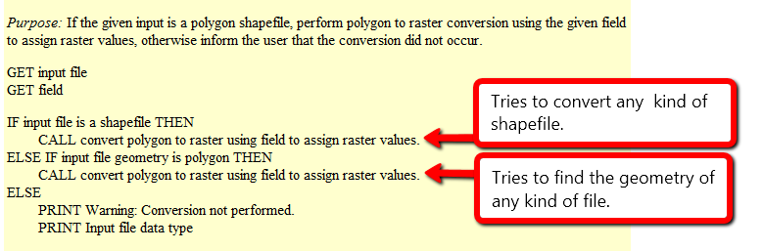
Polygon to raster
Purpose: If the given input is a polygon shapefile, perform polygon to raster conversion using the given field to assign raster values, otherwise inform the user that the conversion did not occur.
What will happen if the input file is…
a polygon shapefile?
convert the data to raster (success)
a point shapefile?
attempt to convert the data to raster, but will fail, since it’s not polygon input but it is a shapefile
a raster file?
attempt to check the geometry of the inputfile and fail, since raster files don’t have a geometry
When does it give a warning?
never

Slide 67
Polygon to raster pseudocode corrected
Instead of else if, use a compound conditional
IF input file is a shapefile AND input file geometry is polygon THEN CALL convert polygon to raster using field to assign raster values.
ELSE PRINT Warning: Conversion not performed. PRINT Input file data type
Moral: TEST ALL CONDITIONS

Slide 68
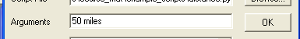
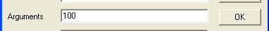
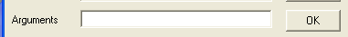
Distance converter example
Convert miles to km or km to miles and handle user input of 2, 1, or 0 arguments:
Arguments: 50 miles
>>> 50 miles is equivalent to 80.0 kilometers.
Arguments: 100
>>> Warning: No distance unit provided. Assuming input is in miles.
100.0 miles is equivalent to 160.0 kilometers.
Arguments:
>>> Usage: <numeric_distance> <distance_unit(miles or km)>

Slide 69
Distance Conversion Pseudocode
GET numeric dist from args
GET unit from args
IF unit is miles THEN COMPUTE km PRINT results
ELSE COMPUTE miles PRINT results
ENDIF
Add to the pseudocode to handle case of 'no user arguments'.
Add pseudocode to part 1 to handle the '1 argument' case.

Slide 70
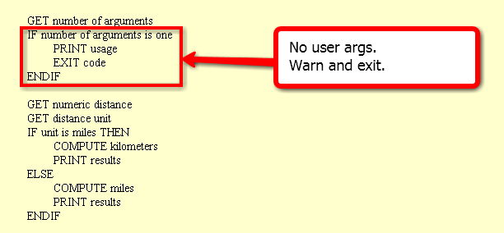
Handle no user arguments case

Slide 71
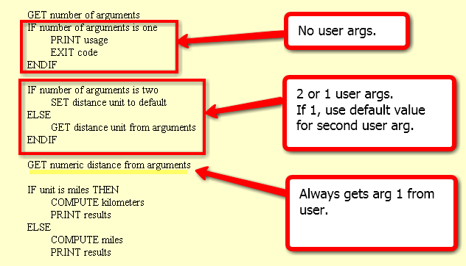
Distance conversion pseudocode
Related code given in examples 9.12 and 9.13 in the book.

Slide 72
Buffer_clip pseudocode
GET number of arguments
IF number of args < 5
PRINT usage EXIT code
ENDIF
SET fire damage
SET park
SET buffer distance
SET workspace
GET number of arguments
IF number of arguments < 4 PRINT usage EXIT code
IF number of args is 4
PRINT warning SET workspace to default
ELSE
SET workspace to last arg
ENDIF
SET fire damage
SET park
SET buffer distance
All or nothing.
How could we make
the last argument (the workspace) optional?

Slide 73
Appendix II

Slide 74
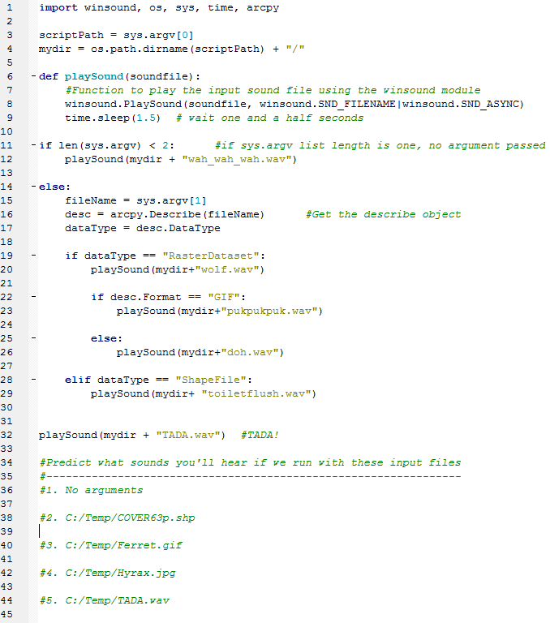
In class – conditionalSound.py (orig)

Slide 75
Buffer_clip… avoid argv index error
Check the list length before indexing it, give feedback, and exit if necessary
use try/except (discuss later)
import sys
listLength = len(sys.argv) # count the number of arguments
if listLength < 5:
print 'Usage: <shapefile to buffer>, <buffer distance>, <shapefile to \ clip>, <the workspace >' # explain the problem to the user
sys.exit(0) # exit the program.
# buffer_clip.py arguments
fireDamage = sys.argv[1]
park = sys.argv[2]
bufferDist = sys.argv[3]
arcpy.env.workspace = sys.argv[4]
# Buffer and clip code below here…

Slide 76
Using if/elif/else
Use if alone when you only want do y if x is true, and you want to continue with the rest of the script in either case.
…
if field_name not in fields: arcpy.addField(filename, field_name)
# Update field values
Use elif to check another conditional statement. Follows if or elif block.
Use else to enact a default action. If none of the previous conditions are true, do what I say. Follows if or elif block.
if shapeType == ‘polygon’:
print 'Shape is polygon'
elif shapeType == ‘line’:
print 'Shape is line'
else:
print 'Shape is not line or polygon'

Slide 77
Ways not to use if, elif
Instead should be
if x == 1:
#do stuff
if x == 2:
#do special stuff
if x == 3:
#do very weird thing
if x == 1:
#do stuff with a
elif x == 2:
#do stuff with b
elif x == 3:
#do stuff with c
elif x == 4:
#do stuff with d
elif x == 5:
#do stuff with e
elif x == 6:
#do stuff with f
…
if x == 1:
#do stuff
elif x == 2
#do special stuff
elif x == 3
#do very weird thing
Don’t use repeated if to check mutually exclusive conditions.
Don’t use a large number of ‘elif’ conditions when consistently testing the same variable’s value and performing the same operation inside.
There are better ways to do this.
Instead should be
using Python
built-in data structure
called a dictionary.
--Dictionaries will be
discussed in a
later lecture.

Slide 78
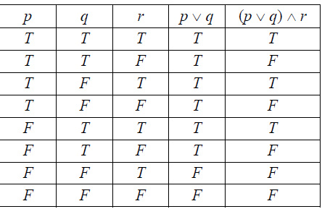
Truth tables usually use \/ for or /\ for and
The expression that goes behind the "if" or "elif" in Python is a Boolean expression (a statement which evaluates as True or False)
p, q, and r represent conditions. slope > 15
It's raining
Today is Friday
In truth tables, /\ represents and
\/ represents or
p: It's raining
q: Today is Friday
p /\ q: It's raining and today is Friday
(p \/ q) /\ r is a compound statement using a logical operator "or" to join p and q and a logical operator "and" to join (p \/ q) with r.
Notes:
A familiarity with introductory logic is helpful in writing well formed conditional code.

Slide 79
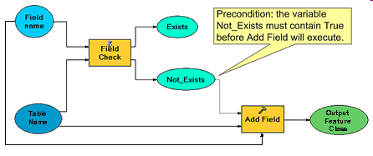
Condition with ‘not’ keyword
Pseudocode
IF field name does not exist THEN CALL Add field ENDIF
CALCULATE FIELD
conditional
statement
Python code
fileName = 'C:/data.shp'
fieldName = 'slope'
fields =['FID', 'rise', 'run']
if fieldName not in fields: arcpy.addField(fileName, fieldName)
print 'New field created.'
arcpy.CalculateField(fileName, fieldName, \ '[rise] / [run]‘)
colon
indent entire if code block (code block = set of related code)
Notes:
#Complete example of code.
import arcpy
fileName = 'C:/Temp/COVER63p.shp'
fieldName = 'Square'
fieldObjs = arcpy.listFields(filename) #we haven’t gone over this yet.
fields=[]
for f in fieldObjs: #we haven’t gone over ‘for’ loops yet.
fields.append(f.name)
if fieldName not in fields:
arcpy.addField(fileName, fieldName)
print 'New field created.'
arcpy.CalculateField(fileName, fieldName, \
'[RECNO]*[RECNO]')
#another way to get the field name list is to use list comprehension:
fields = [f.name for f in fieldObjs]

Slide 80
Tweet this
FOR each folder in the untarred landsat folders
IF folder name starts with LC8 THEN
SET red band to GeoTIFF that ends with band 4
SET blue band to GeoTIFF that ends with band 2
SET NIR band to GeoTIFF that ends with band 5
SET mask to GeoTIFF that ends with cfmask
APPEND to veg_indices list in the order they appear above
ELSE IF folder name starts with LT5 THEN
SET red band to GeoTIFF that ends with band 3
SET blue band to GeoTIFF that ends with band 1
SET NIR band to GeoTIFF that ends with band 4
SET mask to GeoTIFF that ends with band
APPEND to veg_indices list in the order they appear above
END IF
END FOR
Read and interpret the procedure above. In <=200 chars, write sentence to describe it.
Hint, what is repeated in both cases?
Notes:
Answers will vary.
Possible answer 1: For each folder, checks the folder name, sets the raster color bands to the raster ending with the specific bands and adds them to a vegetation index list.
Possible answer 2: For each landset dir, if name LC9*, set R, B, NIR to bands *4, *2, *5, mask *cfmask, else if name *LT5 set R, B, NIR to bands *3, *1, *4, mask *sr_ccloud_qa in case add to list

